Slide 1

Introduction to Bankruptcy Law and the Bankruptcy System:
An Educational Primer for State Courts
[Template Presentation For Educational Use]
This template presentation, provided by
the Federal Judicial Center, combines, edits, and expands presentations given by bankruptcy judges and state trial court judges. Contact Jason A. Cantone, at fedstate@fjc.gov, for more information.
Notes:
This presentation was greatly benefitted by the following individuals, who reviewed an earlier draft of the presentation: Hon. Shon Hastings, Hon. Craig Whitley, Hon. Cate Furay, Hon. Charles L. Nail, Jr., Hon. Ashely Chan, Hon. Robert Kressel, Hon. Robert Drain, Hon. Diane Finkle, Hon. Robert Faris, Elizabeth Wiggins, and Brian Lynch. The presentation utilizes and expands on prior educational materials provided alongside interviews held by Dr. Jason Cantone with: Hon. Dan Collins, Hon. Brian Davis, Hon. Robert Faris, Hon. Cate Furay, Hon. Martin Glenn, Hon. A. Benjamin Goldgar, Hon. Mary Gorman, Hon. Laurel Isicoff, Hon. Catherine McEwen, Hon. Robyn Moberly, Hon. Mindy Mora, Hon. Chris Panos, Hon. Laura Taylor, and Ann M. Anderson. This presentation was made better by all of these individuals, as well as the Judicial Conference Committee on Federal-State Jurisdiction.

Slide 2


Content Note
This presentation only addresses foreclosure. A full presentation with all six topics (bankruptcy overview; automatic stay; bankruptcy discharge; family law; foreclosure; additional considerations) is available at fjc.gov/fedstate, as well as separate presentations for each of those topics.
Notes:
If you would like a Powerpoint that includes the full presentation or the topics provided in the note, please visit fjc.gov/fedstate.

Slide 3
Bankruptcy and
Foreclosure

Slide 4
Automatic Stay and Foreclosure
The automatic stay stops foreclosures against the debtor at any stage:
  nonjudicial foreclosures
  ejectment cases
  judicial foreclosures
Mortgagees’ motions for relief from stay are probably the most common filing.

Slide 5
Automatic Stay and Foreclosure
When the foreclosure is completed and the debtor’s interest in the property is extinguished, the stay no longer protects the property:
  recording of deed in nonjudicial foreclosures
  entry of sale confirmation order in judicial foreclosures
But the stay still protects the debtor from personal liability for any deficiency debt after the foreclosure.

Slide 6
Effect of Order for Relief from the Stay
An order for relief from the stay does only that and nothing more.
  No adjudication of claims.
  No abandonment of property.
  No relinquishment of jurisdiction.
  Usually does not determine who is entitled to possession of collateral.

Slide 7
Serial Filers
The stay expires 30 days after the case is filed in the case of an individual debtor who has had one prior case dismissed within the prior twelve months (unless extended for cause).
There is no stay in a case filed by an individual debtor who has had two prior cases dismissed within the prior twelve months (debtor must seek to impose the stay within the first 30 days of bankruptcy).
In rem relief is available to a lender.
The stay may be extended by the bankruptcy court for cause.
Notes:
Again, as noted on a prior slide:
Caution: The law regarding to what extent the automatic stay terminates after 30 days for an individual who files a case within a year of the existence of a prior case is controversial.
See Rose v. Select Portfolio Servicing Inc., 945 F.3d 226 (5th Cir. 2019); contra, In re Smith, 910 F.3d 576 (1st Cir. 2018).

Slide 8
Foreclosure After Chapter 13
Many lenders misapply payments during Chapter 13.
Many lenders pile on “hidden” charges during Chapter 13.
Motions to Deem Mortgage Current seek to avoid “surprises” at the end of the plan.

Slide 9
Foreclosure After Chapter 13
Transfers of the mortgage often create accounting difficulties.
Advice:
  To ensure proper accounting, many bankruptcy courts require mortgage plan payments be made through the trustee (as opposed to direct payments to the creditor).
  Modification can occur with multiple pieces of collateral.

Slide 10
Receivers and Commissioners
A receiver or commissioner must turn over property of the estate once a bankruptcy is filed.
A receiver or commissioner may seek to be “excused” from turning over property of the estate.
Only the bankruptcy court can determine whether turnover may be “excused.”
Note: The sheriff is often the party in possession of the debtor’s property.

Slide 11
Can bankruptcy solve a foreclosure problem?
Automatic stay halts foreclosure–but only temporarily–and discharge does not halt foreclosure.
The Bankruptcy Code generally does not allow a debtor to nonconsensually modify a loan secured only by debtor’s residence–no principal reduction, interest adjustment, or reamortization.
Modification can occur with multiple pieces of collateral.
Note: Chapter 12 rules differ.

Slide 12
Can bankruptcy solve a foreclosure problem?
(cont’d)
Chapter 13 allows “cure and maintenance.”
Debtors can “strip off” wholly unsecured junior mortgages and liens.

Slide 13
Can bankruptcy solve a foreclosure problem?
(cont’d)
Note: Many bankruptcy courts have court-supervised loss-mitigation programs in which homeowner borrowers and mortgage holders negotiate a possible consensual loan/mortgage modification.
If such an agreement is reached, these programs generally provide for an order approving the modification and governing the parties thereafter.

Slide 14
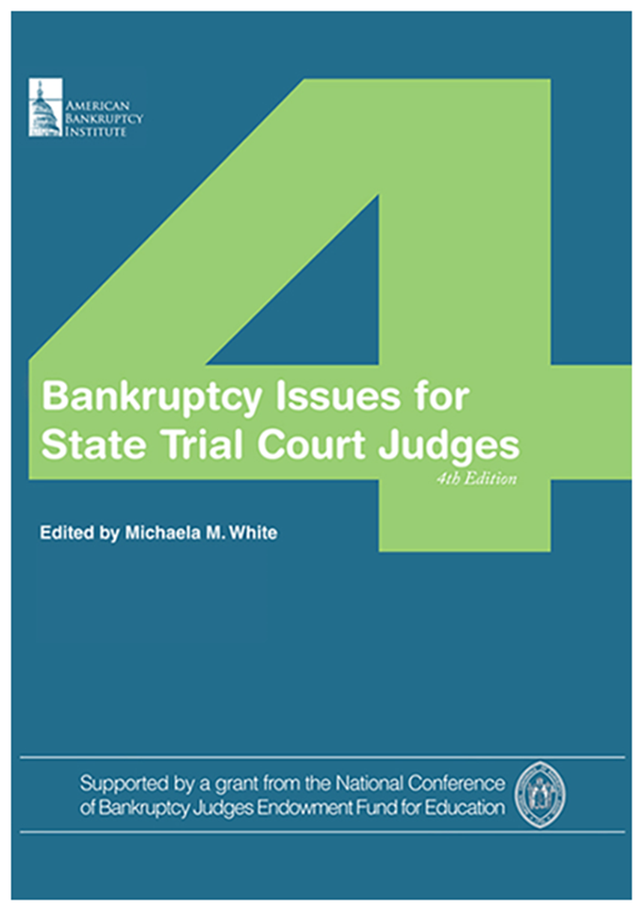
Additional
Resources
Federal Judicial Center website on federal-state cooperation: https://fjc.gov/fedstate
National Center for State Courts resource guide on foreclosures: https://www.ncsc.org/Topics/Financial/Foreclosures/Resource-Guide.aspx

Slide 15
Thank You
This presentation was organized
by Federal Judicial Center Senior Research Associate Jason A. Cantone, with considerable assistance by a number of federal and state judges and court personnel (see note for slide 1).
Questions about the presentation and its use can be directed to
Dr. Cantone, at fedstate@fjc.gov. We would also like to hear from you if you find it helpful or have any recommendations to improve it.

